Slide 1
Office 365 Development Overview

Slide 2
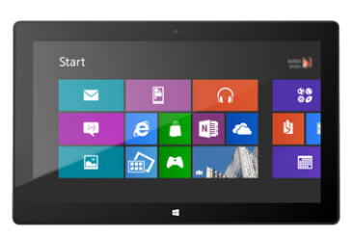
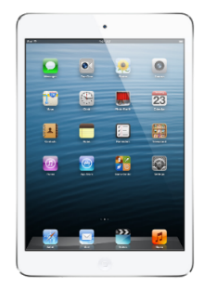


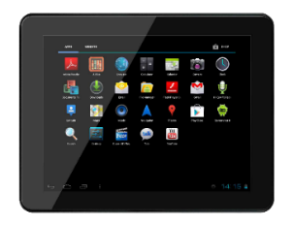
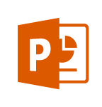
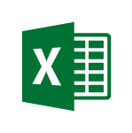
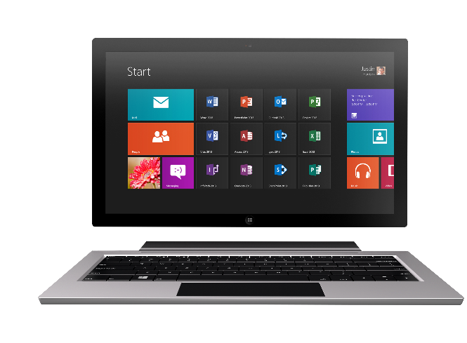
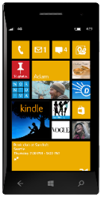
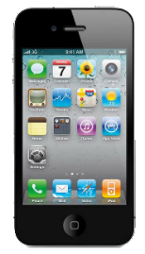
Technology journey
PC
1990s
PC + Servers
2000s
Devices + Cloud
2010s
VBA
VBA
Com add-ins
VSTO
FTC
Open standards
Mobile SDK’s
Notes:
Technology Journey
Respect for the investments that you’ve already made
Reaching out to a whole new world of possible.

Slide 3
Office 365 Environment
Office
Exchange
SharePoint
OneDrive for Business
Azure Active Directory (AAD)
Notes:
SharePoint Online provides a solid business collaboration platform on which developers can build solutions quickly by using familiar development tools. In addition to in-browser customizations, SharePoint Online supports development with Microsoft SharePoint Designer 2010, Microsoft Visual Studio 2010, and Microsoft Visual Studio Team Foundation Server 2010. SharePoint Online enables you to modify sites directly and deploy code as sandboxed solutions that are run in a protected environment to safeguard the environment from poorly performing or malicious code.
SharePoint Online opens a new arena for developers to create solutions for customers who use the Office 365 service instead of maintaining on-premises servers, or for clients who want to take advantage of hybrid deployments where some data is stored behind the firewall and other data is off-loaded in the cloud.

Slide 4


Contextual Apps
Your Apps, our UI
Surface your apps in the Office 365 platform
In Context
In context of your business users productivity activities
Reach
In Office Client, Office Online and Modern Apps
Notes:
The Cloud App Model provides a loosely coupled architecture for building apps in SharePoint 2013. This loosely coupled architecture gives the freedom of choice for developers in the technologies they use to not only host their applications but also the tools they use to write them. These apps leverage industry web standards such as HTML, JavaScript, jQuery, JSON, REST, OData and OAuth to provide apps an integrated user experience, yet architecturally provides for loose coupling with SharePoint 2013.
Apps for SharePoint execute “off-server” which allows for the app to scale independently of SharePoint and provides for a more secure SharePoint environment. You have complete control how apps interact with SharePoint. IT has complete control on how users discover, acquire and license apps. IT can specify which apps are white listed for install, or provide a mechanism where users can request an app that requires IT approval to install.
Apps can be accessible from any device with a web browser whether it be a PC, Tablet or smart phone. If it has a web browser that supports the latest web standards then it can be used.
Supporting Technologies
Client Side Rendering
Cloud App Model
REST End-Points
Client Object Model
OAuth 2.0
Visual Studio
NAPA

Slide 5

Web Standards
Apps are built using industry proven web standards such as HTML, JavaScript and REST
Scalable and Safe
Apps are independently scalable which reduces total cost of ownership. Apps are secured and isolated from SharePoint
Accessible
Apps can be accessed from any device with a web browser.
Build apps
Notes:
The Cloud App Model provides a loosely coupled architecture for building apps in SharePoint 2013. This loosely coupled architecture gives the freedom of choice for developers in the technologies they use to not only host their applications but also the tools they use to write them. These apps leverage industry web standards such as HTML, JavaScript, jQuery, JSON, REST, OData and OAuth to provide apps an integrated user experience, yet architecturally provides for loose coupling with SharePoint 2013.
Apps for SharePoint execute “off-server” which allows for the app to scale independently of SharePoint and provides for a more secure SharePoint environment. You have complete control how apps interact with SharePoint. IT has complete control on how users discover, acquire and license apps. IT can specify which apps are white listed for install, or provide a mechanism where users can request an app that requires IT approval to install.
Apps can be accessible from any device with a web browser whether it be a PC, Tablet or smart phone. If it has a web browser that supports the latest web standards then it can be used.
Supporting Technologies
Client Side Rendering
Cloud App Model
REST End-Points
Client Object Model
OAuth 2.0
Visual Studio
NAPA

Slide 6

Write once, run anywhere
An app can run outside the firewall in the cloud and from inside the firewall in a data center.
Hosting freedom
Apps can be hosted on any platform giving you complete freedom.
Re-use logic and assets
Build apps that can share logic and code with other web hosted solutions. Re-use existing services and assets within you app.
Build for the cloud
Notes:
By nature the Cloud App Model allows for the implementation of the app to be independent of the SharePoint platform. This gives you freedom of choose in how you develop and host your apps. This means you could develop them using Microsoft tools or non-Microsoft tools such as Eclipse. You can host the on Windows Azure or host them in Linux, Amazon Web Services, etc… The choices are endless and completely up to you.
The apps you right can re-use logic and code you already have for other web based apps or services. Or you can use logic and code for an app in other web apps or services. That’s the power and freedom of the cloud.
Supporting Technologies
Cloud App Model
Platform Agnostic

Slide 7
Office 365 Development Options
 | Apps for SharePoint | Apps for Office | Office 365 APIs
Word Excel |  | Task Pane App Content App
Outlook |  | Mail App | Mail Calendar Contacts
SharePoint | SharePoint-Hosted App Cloud-Hosted App |  | Files Sites
OneDrive for Business |  |  | Files

Slide 8
Continuous innovation
LAST YEAR
THIS YEAR
THE FUTURE
Apps for SharePoint
Apps for Office
VS tooling
Store and lifecycle
Contextual apps
Compose time apps
Robust Office 365 APIs
Tools and platform
Android SDK
Adding new endpoints
More APIs (Tasks, Office Graph)
iOS SDK
Embracing Open
Integrating platform + Tools
Empowering users
Notes:
Specific talking points on “show some leg:”
Endpoints
Building Apps for Office on the MAC
Filling in Apps in Office Online, Word
Connecting Entities
Adding Entities for feeds and tasks.
Embracing more of O365
Working on tools to help developers navigate between entities, like you see in Pulse (We’re showing this, right?)
Embracing Open
Double-down on open standards, interop, protocols and programming frameworks
Making more open source projects
Contributing to more open source projects
Integrating Platform
Easier to manage apps across Azure and O365
More support from VS for apps across not just SharePoint, but all of O365
Empowering Users
Make it easier for users to build solutions without code
Connect those solutions to enhancement from pro-devs

Slide 9


Distribution choices
Office Store
App Catalog
Notes:
Lifecycle
Not just the store
Momuntem has been building store and on-prem
Store features ; subscriptions
Business-ready
Corporate catalog
Training users to get new experiences

Slide 10

App Model Development
If you know general web development, you also know Office 365 development…
Notes:
Same code works in cloud and in on-premises
Build market place apps and reach all Office 365 customers easily
More flexible model with additional possibilities
Standard .NET development tooling

Slide 11
Setting up Environments
Sign up for an Office 365 subscription
Create a Developer Site Collection
Sign up for Windows Azure subscription
Link Office 365 AAD to Windows Azure
Make Office 365 user administrator in Windows Azure
Use Visual Studio remotely to develop

